Slide 1
21st Century Skills
Leadership

Slide 2
Objectives
What is leadership?
Identify the traits and skills of an effective leader
Key leadership theories
Examine the role, duties and responsibilities of a Team Leader in the workplace
Understand the limits of authority in a Team Leader role
Develop a plan to develop your own leadership potential

Slide 3
Understanding Leadership
What is leadership?
Why is leadership important – why do we need leaders?
Leaders – born or bred?

Slide 4
"Leadership is a function of knowing yourself, having a vision that is well communicated, building trust among colleagues, and taking effective action to realize your own leadership potential."
Prof. Warren Bennis

Slide 5
Understanding Leadership
Discuss examples you have come across of strong and weak leadership
You can use examples from employment, academic studies or participation in sports clubs and societies (keep anonymous)

Slide 6
Leadership Theory
Early Theories:
Great Man Theories
Leaders are exceptional people, born with innate qualities, destined to lead
Term 'man' was intentional - concept was primarily male, military and Western
Trait Theories
Research on traits or qualities associated with leadership are numerous
Traits are hard to measure. For example, how do we measure honesty or integrity?

Slide 7
Leadership Traits
Choose leaders YOU admire
What personality traits and skills do they have?

Slide 8
Leadership Traits and Skills
Traits
Adaptable to situations
Alert to social environment
Ambitious and achievement orientated
Assertive
Cooperative
Decisive
Dependable
Dominant (desire to influence others)
Energetic (high activity level)
Persistent
Self-confident
Tolerant of stress
Willing to assume responsibility
Skills
Clever (intelligent)
Conceptually skilled
Creative
Diplomatic and tactful
Fluent in speaking
Knowledgeable about group task
Organised (administrative ability)
Persuasive
Socially skilled
Leaders will also use:
Integrity, Honesty, Compassion, Humility

Slide 9
Leadership Theory
Functional Theories (John Adair, Action Centred Leadership, 1970)
Leader is concerned with the interaction of 3 areas:
Task – goal setting, methods and process
Team – effective interaction/communication, clarify roles, team morale
Individual – attention to behaviour, feelings, coaching, CPD

Slide 10
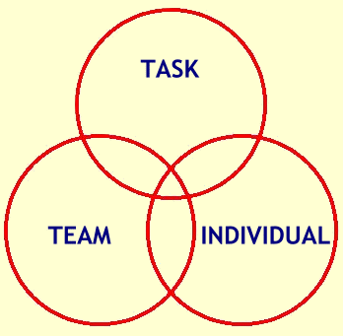
Leadership Theory
Behaviourist Theories (Blake and Mouton, Managerial grid, 1964)
Leaders behaviour and actions, rather than their traits and skills e.g. production orientated or people orientated
Different leadership behaviours categorised as ‘leadership styles’ e.g. autocratic, persuasive, consultative, democratic
Doesn’t provide guide to effective leadership in different situations

Slide 11
Leadership Theory
Situational/contingency Leadership (Hersey-Blanchard, 1970/80) Leadership style changes according to the 'situation‘ and in response to the individuals being managed – their competency and motivation
Competency | Low competence | Some competence | High competence | High competence
Motivation | Low commitment/ Unable and unwilling or insecure | Variable commitment/ Unable but willing or motivated | Variable commitment/ Able but unwilling or insecure | High commitment/ Able and willing or motivated
Leadership style | DIRECTIVE (Telling) | COACHING (Selling) | SUPPORTIVE (Participating) | DELEGATORY (Observing)

Slide 12
New Leadership Theory
Transformational Theory (Bass and Avolio, 1994)
Leaders inspire individuals, develop trust, and encourage creativity and personal growth
Individuals develop a sense of purpose to benefit the group, organisation or society. This goes beyond their own self-interests and an exchange of rewards or recognition for effort or loyalty.

Slide 13
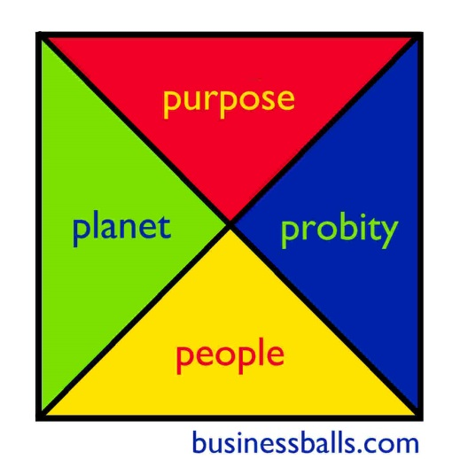
Leadership Philosophies
Ethical Leadership
CSR, sustainability, equality, humanitarianism
Four P’s - Purpose, People, Planet, Probity
Alan Chapman, 2006

Slide 14
What are the key responsibilities of the team leader role?

Slide 15
Key Team Leader Responsibilities
Guide/coordinate team members – encourage teamwork and motivate individuals
Provide structure for team – set mission and purpose, clarify roles and responsibilities, allocate tasks and set objectives
Clarify working methods, practises and protocol
Focus on performance – anticipate challenges, monitor performance, delegate and provide CPD support

Slide 16
Accountability, Responsibility, and Authority
Accountability the state of being accountable, liable, or answerable
Responsibility (for objects, tasks or people) can be delegated but accountability can not – buck stops with you!
A good leader accepts ultimate responsibility:
will give credit to others when delegated responsibilities succeed
will accept blame when delegated responsibilities fail
Accountability can not operate fairly without the leader being given full authority for the responsibilities concerned
Authority is the power to influence or command thought, opinion or behaviour
Cross-functional team – less authority - more difficult to manage

Slide 17
When have you experienced an issue as a leader that you did not have the authority to resolve?
How did you know you did not have the authority?
Who did you refer to for help?

Slide 18
Team Leader Authority
Team Leader authority will vary from role to role dependent on the scope of duties and organisational structure
A Team Leader may refer to line management or other
authorities for the following:
HR (staff recruitment and training, performance and discipline, racism or bullying)
Policy and procedures (Health and Safety, changes to working practises)
Budget & resources (allocation and management)
Organisational objectives (strategy, targets)
Managing change (department restructure, office move)
Line management (support and advice, own CPD)

Slide 19
How to improve your leadership skills
Reflect and identify the skills YOU need to lead effectively and create your action plan to develop them
Ask for feedback from work colleagues, line managers, tutors, your ‘followers’
Practice! Take on responsibility (work, volunteering, clubs & Societies) and reflect on your performance
Find a mentor – learn from positive leadership role-models
Attend further leadership and management training
Use the resources on Exeter Leaders Award ELE pages

